Slide 1


Driver Drowsiness Detection system
Shalu Guntupally -16338636
Charan
Mallikarjun
Sagarika

Slide 2
ABSTRACT
Driver drowsiness detection systems play a crucial role in ensuring road safety by monitoring the fatigue levels of drivers during their journeys.
This technological solution aims to prevent accidents caused by drowsy driving, a leading factor in road incidents.
The system typically utilizes computer vision techniques to analyze facial features and head movements, assessing indicators such as eye closure, mouth activity, and head pose.
Upon detecting signs of drowsiness, the system triggers timely alerts, such as alarms or visual warnings, prompting the driver to take corrective actions.
The integration of driver drowsiness detection systems in vehicles represents a proactive approach to mitigate the risks associated with driver fatigue, contributing to enhanced road safety and accident prevention.

Slide 3
Introduction
The Drowsiness Detection System presented is a computer vision-based solution designed to enhance safety in scenarios where alertness is critical.
The system utilizes facial feature analysis, focusing on
Eye Aspect Ratio (EAR)
Mouth Aspect Ratio (MAR)
Head Pose Estimation
The real-time monitoring and analysis of these features enable the system to detect signs of drowsiness and issue alerts promptly

Slide 4
Requirements
Software:
Spyder software (programming language)
Visual code for c++
OpenCV (computer vision library)
Dlib (machine learning library)
NumPy (numerical computing library)
imutils (image processing library)
pygame (sound library)
Hardware:
Webcam or camera for video input
Computer with sufficient processing power for real-time image processing

Slide 5
Modules
3.1 Eye Aspect Ratio (EAR):
EAR is a crucial metric in drowsiness detection, measuring the aspect ratio of the eye. As a person becomes drowsy, the eyes tend to close, causing a decrease in EAR. This module actively monitors EAR, issuing alerts when it falls below a defined threshold.
EAR (Eye Aspect Ratio) is a measure used in facial recognition and drowsiness detection systems. It quantifies the level of openness of the eyes by considering the relative distances between key points on the eye. The formula for calculating the EAR is as follows:
EAR=∥2C1​−C5​∥+∥2C2​−C4​∥​ divided by 2.||C0-C3|| Where:
C0C0​ to C5C5​ are six specific points on the eye contours (corners and ends).
∥∥∥∥ denotes the Euclidean distance between two points.
The Euclidean distance between two points (x1,Y1) (x2​,y2​) in a two-dimensional space is calculated using the following formula:
Euclidean Distance=square root of (x2​−x1​)^2+(y2​−y1​^)2​

Slide 6
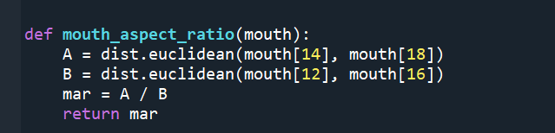
3.2 Mouth Aspect Ratio (MAR):
MAR focuses on the aspect ratio of the mouth, providing additional insights into the user's state. An increased MAR, indicative of mouth opening, serves as an alert trigger, complementing the EAR module for more robust drowsiness detection.

Slide 7
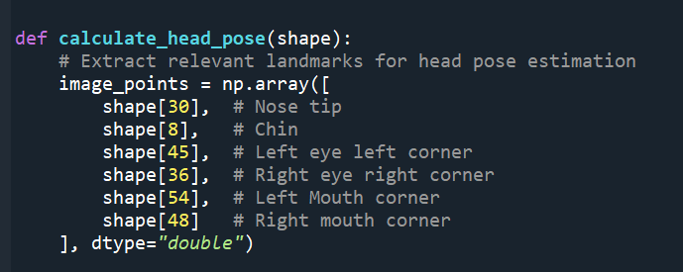
3.3 Head Pose Estimation:
Head Pose Estimation adds a layer of sophistication by analyzing the orientation of the user's head. By assessing the rotation and translation vectors, the system gains insights into head movements, contributing to a comprehensive understanding of the user's alertness level.

Slide 8
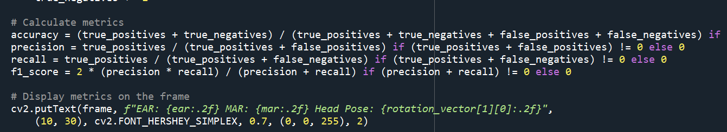
3.4 Accuracy Metrics:
The system incorporates accuracy metrics such as True Positives, True Negatives, False Positives, and False Negatives. These metrics contribute to the evaluation of the system's performance, providing quantitative measures of accuracy, precision, recall, and F1 score.

Slide 9
4. System Operation:
The system continuously captures video frames from a webcam.
Facial landmarks are detected using the dlib library, providing key points for feature analysis.
The EAR and MAR modules assess the eye and mouth states, respectively, for signs of drowsiness.
Head Pose Estimation adds an extra layer of vigilance by analyzing head movements.
Alerts are issued in real-time when drowsiness is detected, accompanied by a sound alarm.

Slide 10
Conclusion
The Drowsiness Detection System demonstrates the practical application of computer vision in ensuring safety. By combining multiple facial features and accuracy metrics, the system provides a comprehensive solution for timely drowsiness detection. This report showcases the significance of leveraging technology to address real-world challenges and enhance user safety.

Slide 11
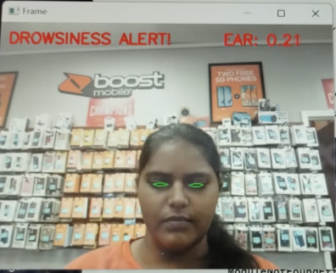
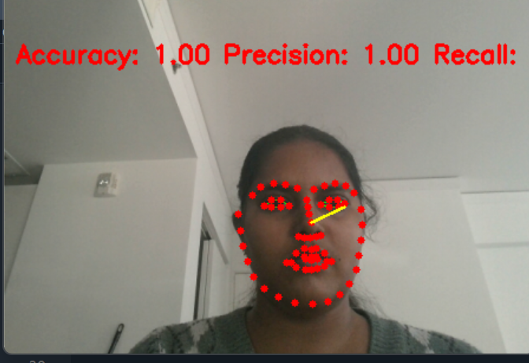
Results

Slide 12
Future Scope
The Drowsiness Detection System presented in the code is a foundation for enhancing safety in scenarios where user alertness is crucial. To further extend and improve the system, several future scope enhancements can be considered:
Driver Identification: Integrate facial recognition techniques to identify the driver or user. This allows for personalized monitoring, and the system can adapt to individual characteristics, enhancing accuracy.
Machine Learning for Personalization: Utilize machine learning techniques to train the system on individual patterns of drowsiness. This can enhance the system's accuracy over time by adapting to the specific characteristics of each user.
Cloud Integration: Enable cloud-based analysis for remote monitoring and data storage. This facilitates data analytics, pattern recognition, and the potential for collaborative research in drowsiness detection

